Slide 1
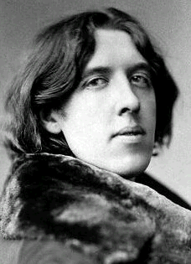
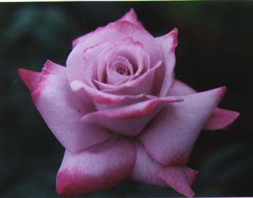
The Rich Odor of Roses…

Slide 2
The Home Front
Hardware Display, The Crystal Palace, London, 1851
L’Éxposition universelle, Paris, 1900

Slide 3
Overseas: Richard Caton Woodville, “Relief of the Light Brigade” (1897)

Slide 4
John Atkinson Grimshaw “The Thames by Moonlight with Southwark Bridge” (1884)

Slide 5
Atkinson Grimshaw,“Liverpool Quay by Moonlight” (1887)

Slide 6
James McNeill Whistler “Nocturne in Black and Gold: The Falling Rocket” (1874-77)

Slide 7
James McNeill Whistler “Nocturne in Blue and Gold– Old Battersea Bridge” (1872-75)

Slide 8
Emily Mary Osborn, “Nameless and Friendless” (1857)

Slide 9
John Singer Sargent “Lord Ribblesdale” (1902)

Slide 10
John Singer Sargent “Dr. Pozzi at Home” (1881)

Slide 11
GiovanniBoldini “Portrait of Comte de Montesquiou-Frezenac” (1897)

Slide 12
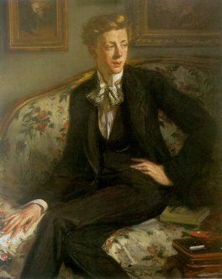
Jacques-Emile Blanche, “Sir Coleridge Kennard sitting on the sofa, or The Portrait of Dorian Gray’ (1904) Jacques-Emile Blanche, “Aubrey Beardsley” (1895)

Slide 13
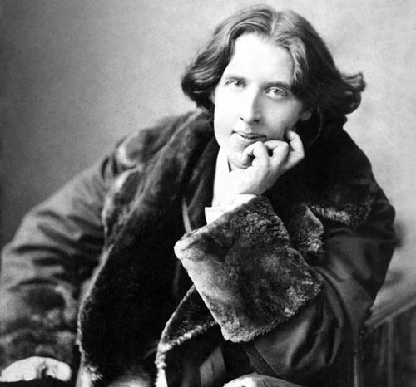
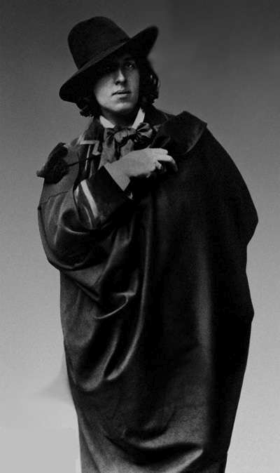
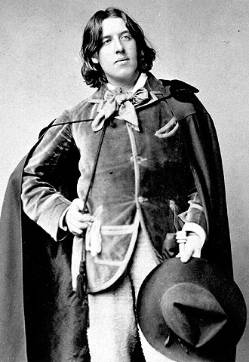
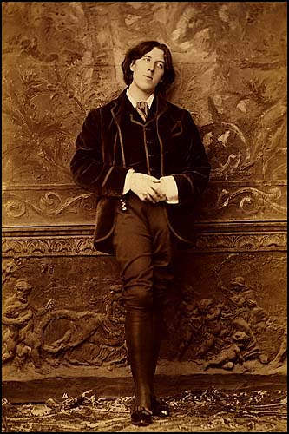
Oscar Wilde as Personality

Slide 14
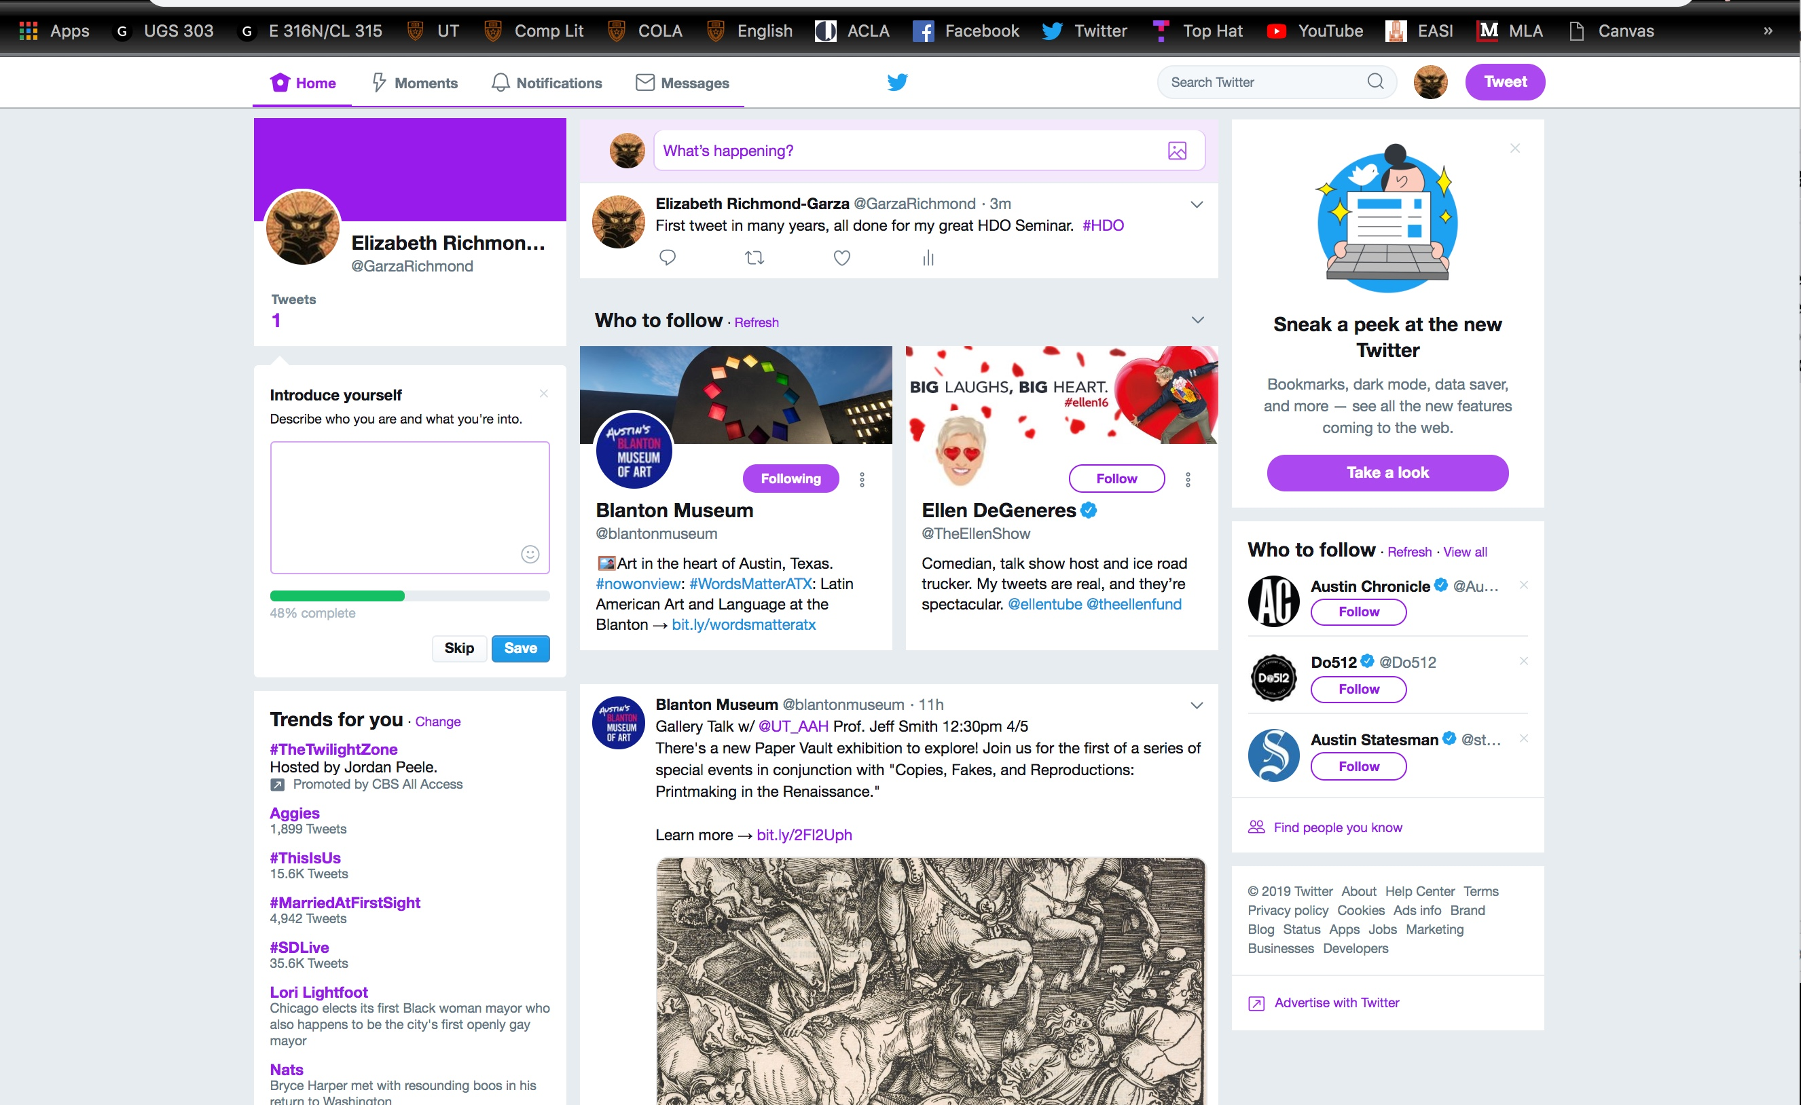
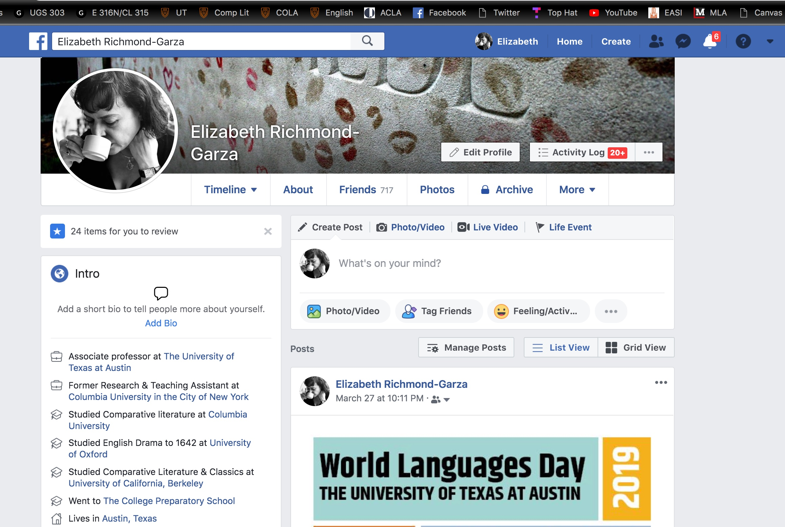
Victorian Double Lives

Slide 15
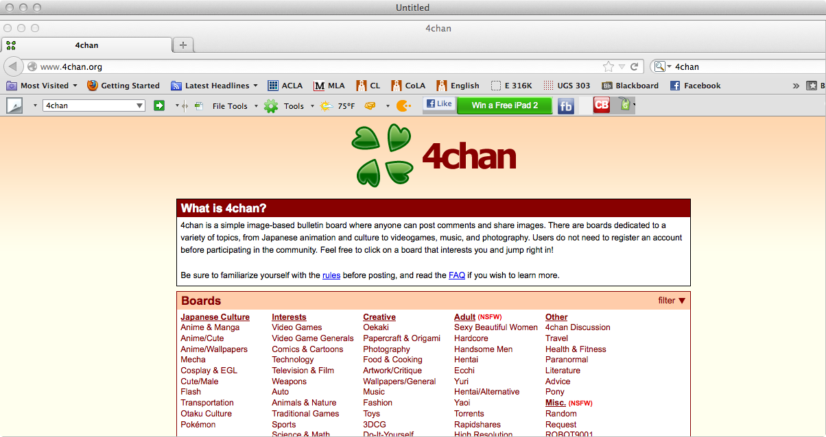

Slide 16
Oscarisms (140 characters or fewer)
Always forgive your enemies - nothing annoys them so much. (50 characters)
True friends stab you in the front. (30)
The only way to get rid of temptation is to yield to it... I can resist everything but temptation. (81)
Experience is simply the name we give our mistakes. (44)
To love oneself is the beginning of a lifelong romance. (47)

Slide 17
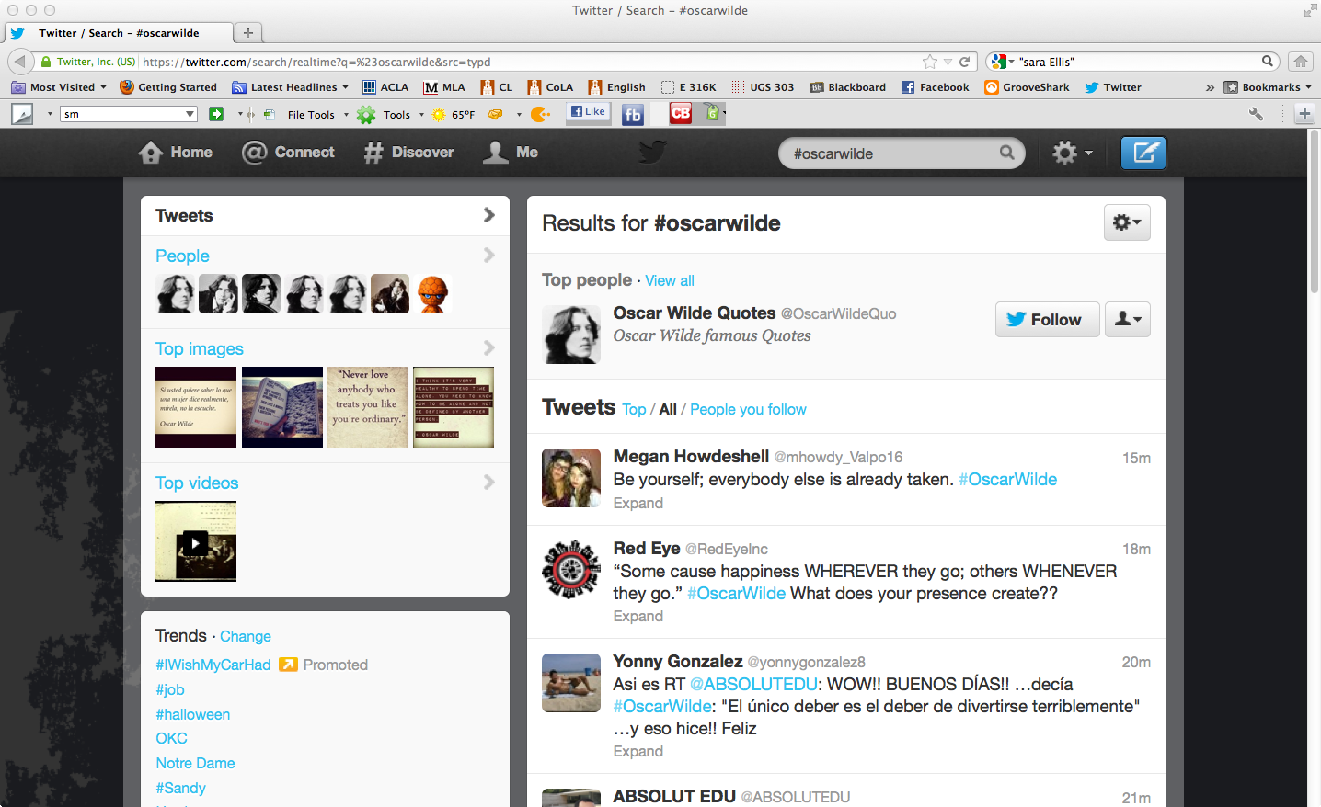
#OscarWilde

